Slide 1


Cloud Infrastructure Week#4
Emrah Mutlu
January 2024

Slide 2
AGENDA – WEEK#4
Cloud Computing Services
Kubernetes (K8s) Services / AKS
Container Apps
Container Instances
Azure Functions
How to Choose a Compute Service
Lab Sessions:
Lab: Testing compute instances on Cloud

Slide 3
Computing Services

Slide 4
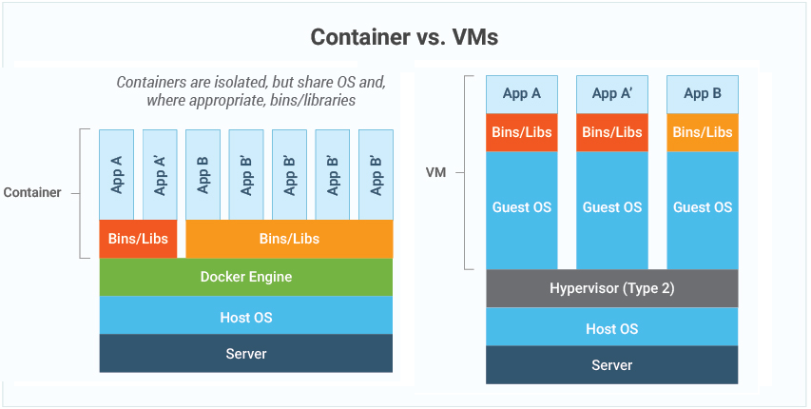
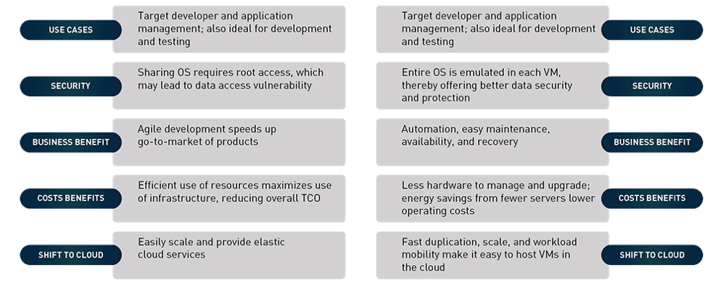
DIFFERENCES BETWEEN THE VM AND CONTAINERS

Slide 5
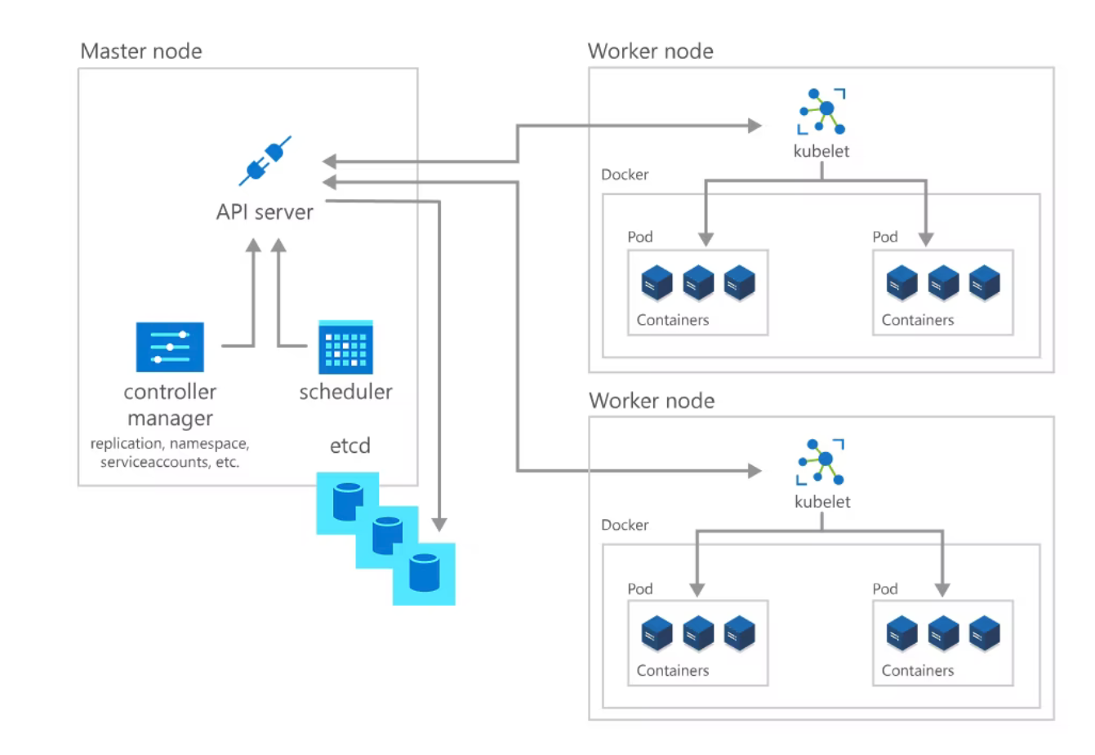
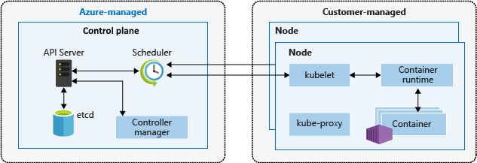
AZURE K8S SERVICES (ARCHITECTURE)
Kubernetes is a cluster of virtual or on-premises machines. These machines—called nodes—share compute, network, and storage resources. Each cluster has one master node connected to one or more worker nodes. The worker nodes are responsible for running groups of containerized applications and workloads, known as pods, and the master node manages which pods run on which worker nodes.
Kubernetes cluster is divided into two components:
Control plane: provides the core Kubernetes services and orchestration of application workloads.
Nodes: run your application workloads.
A Kubernetes cluster contains at least one main plane and one or more nodes. Both the control planes and node instances can be physical devices, virtual machines, or instances in the cloud. The default host OS in Kubernetes is Linux, with default support for Linux-based workloads.
The Kubernetes control plane in a Kubernetes cluster runs a collection of services that manage the orchestration functionality in Kubernetes.
A node in a Kubernetes cluster is where your compute workloads run. Each node communicates with the control plane via the API server to inform it about state changes on the node.
Developers and operators interact with the cluster primarily through the master node by using kubectl, a command-line interface that installs on their local OS. Commands issued to the cluster through kubectl are sent to the kube-apiserver, the Kubernetes API that resides on the master node. The kube-apiserver then communicates requests to the kube-controller-manager in the master node, which is in turn responsible for handling worker node operations. Commands from the master node are sent to the kubelet on the worker nodes.
The master node maintains the current state of the Kubernetes cluster and configuration in the etcd, a key value store database. To run pods with your containerized apps and workloads, you must describe a new desired state to the cluster in the form of a YAML file. The kube-controller-manager takes the YAML file and tasks the kube-scheduler with deciding which worker nodes the app or workload should run based on predetermined constraints. Working in concert with each worker node’s kubelet, the kube-scheduler starts the pods, watches the state of the machines, and is overall responsible for the resource management.

Slide 6
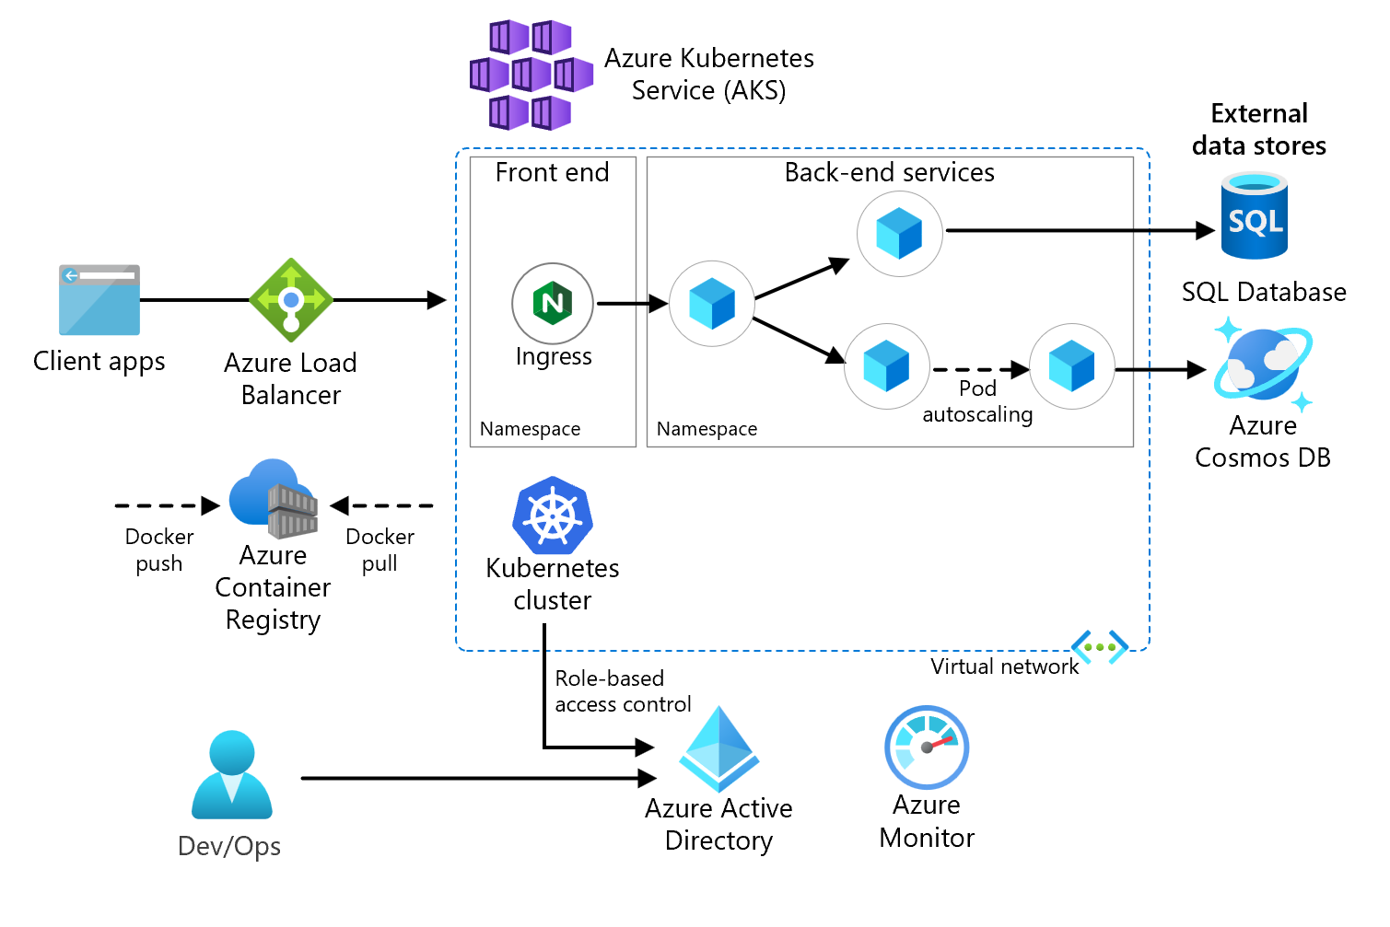
AZURE K8S SERVICES (AKS) IN CHARGE
Azure Kubernetes Service (AKS). AKS is a managed Kubernetes cluster hosted in the Azure cloud. Azure manages the Kubernetes API service, and you only need to manage the agent nodes.
Virtual network. By default, AKS creates a virtual network into which agent nodes are connected. You can create the virtual network first for more advanced scenarios, which lets you control things like subnet configuration, on-premises connectivity, and IP addressing.
Ingress. An ingress server exposes HTTP(S) routes to services inside the cluster.
Azure Load Balancer. Once the AKS cluster is created, the cluster is ready to use the load balancer. Then, once the NGINX service is deployed, the load balancer is configured with a new public IP that will front your ingress controller. This way, the load balancer routes internet traffic to the ingress.
External data stores. Microservices are typically stateless and write state to external data stores, such as Azure SQL Database or Azure Cosmos DB.
Azure Active Directory. AKS uses an Azure Active Directory (Azure AD) identity to create and manage other Azure resources such as Azure load balancers. Azure AD is also recommended for user authentication in client applications.
Azure Container Registry. Use Container Registry to store private Docker images, which are deployed to the cluster. AKS can authenticate with Container Registry using its Azure AD identity. AKS doesn't require Azure Container Registry. You can use other container registries, such as Docker Hub.
Azure Monitor. Azure Monitor collects and stores metrics and logs, application telemetry, and platform metrics for the Azure services. Use this data to monitor the application, set up alerts, dashboards, and perform root cause analysis of failures. Azure Monitor integrates with AKS to collect metrics from controllers, nodes, and containers.

Slide 7
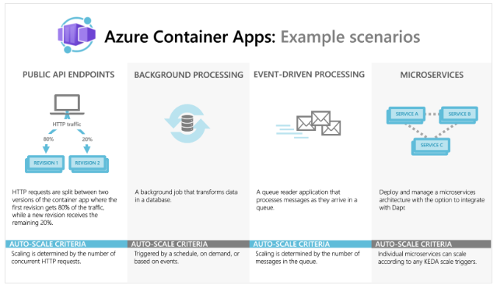
CONTAINER APPS
Azure Container Apps enables you to build serverless microservices and jobs based on containers.
Container Apps is optimized for running general purpose containers, especially for applications that span many microservices deployed in containers.
Container Apps is powered by Kubernetes and open-source technologies like Dapr, KEDA, and envoy.
Container Apps supports Kubernetes-style apps and microservices with features like service discovery and traffic splitting.
Container Apps enables event-driven application architectures by supporting scale based on traffic and pulling from event sources like queues, including scale to zero.
Container Apps supports running on demand, scheduled, and event-driven jobs.
Azure Container Apps doesn't provide direct access to the underlying Kubernetes APIs. If you require access to the Kubernetes APIs and control plane, you should use Azure Kubernetes Service.

Slide 8
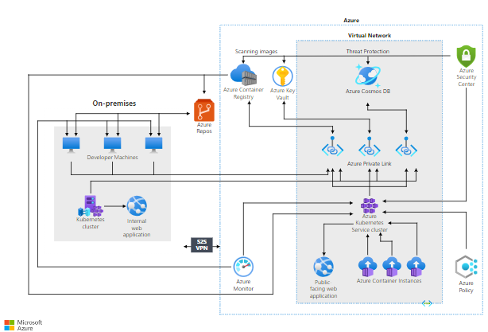
CONTAINER INSTANCES
Azure Container Instances (ACI) provides a single pod of Hyper-V isolated containers on demand.
It's a simpler and more flexible option than Container Apps.
Concepts like scale, load balancing, and certificates aren't provided with ACI containers.
Users often interact with Azure Container Instances through other services.
For example, Azure Kubernetes Service can layer orchestration and scale on top of ACI through virtual nodes.
If you need a less "opinionated" building block that doesn't align with the scenarios Azure Container Apps is optimizing for, Azure Container Instances is an ideal option.

Slide 9
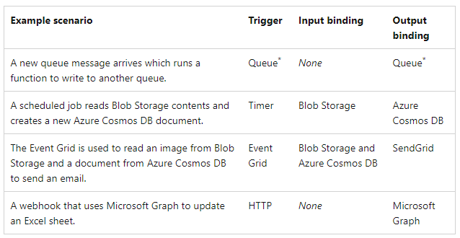
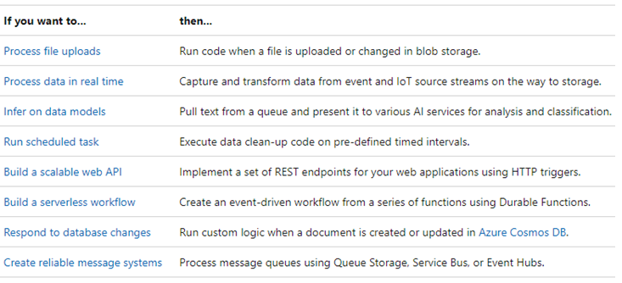
AZURE FUNCTIONS
Azure Functions is a serverless solution that allows you to write less code, maintain less infrastructure, and save on costs.
Functions provides a comprehensive set of event-driven triggers and bindings that connect your functions to other services without having to write extra code.
The following are a common set of integrated scenarios that feature Functions.
Functions support C#, Java, JavaScript, PowerShell, Python, TypeScript, Go and Rust programming languages.
Functions support Consumption (pay by each function run) and Premium (scale on demand, pre-warmed resources for better performance) plans to save costs.

Slide 10
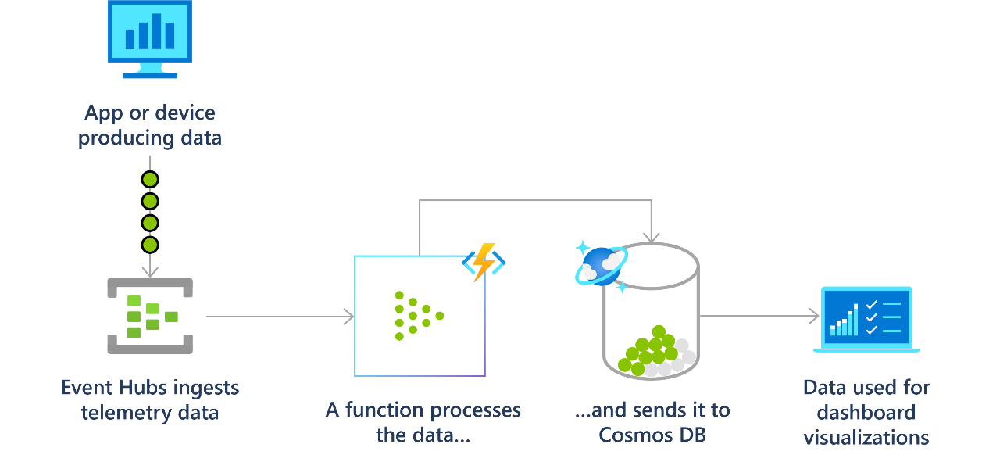
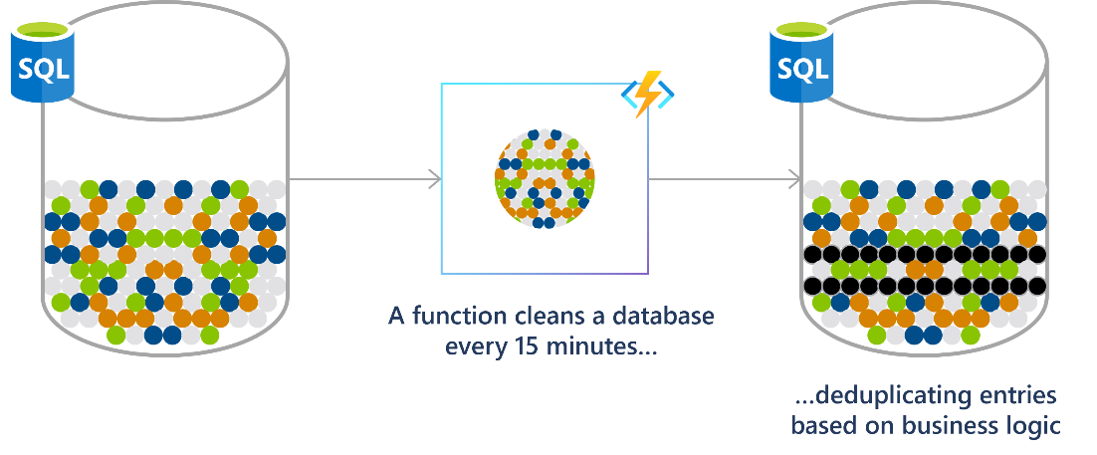
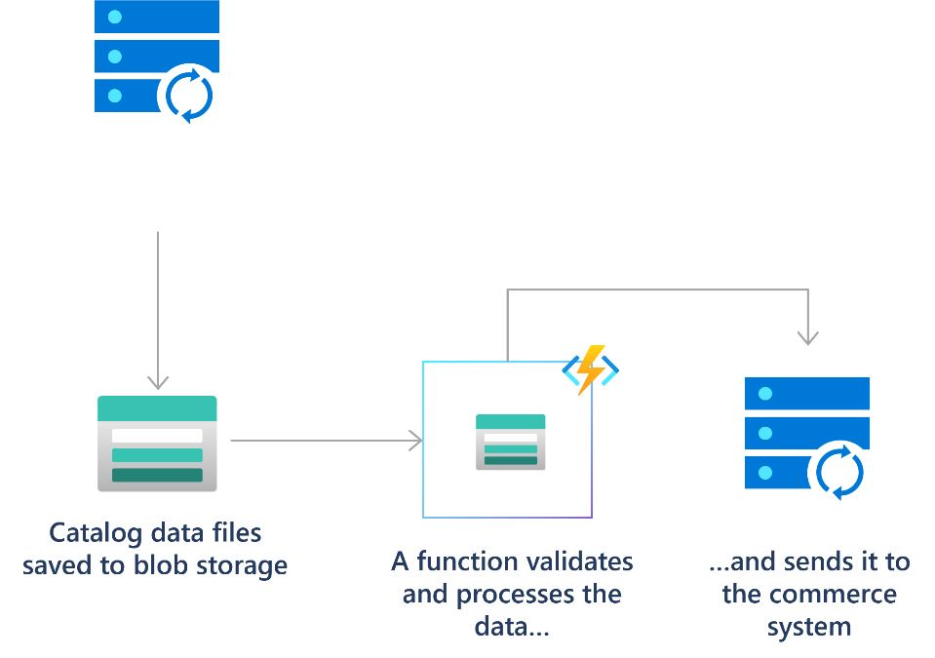
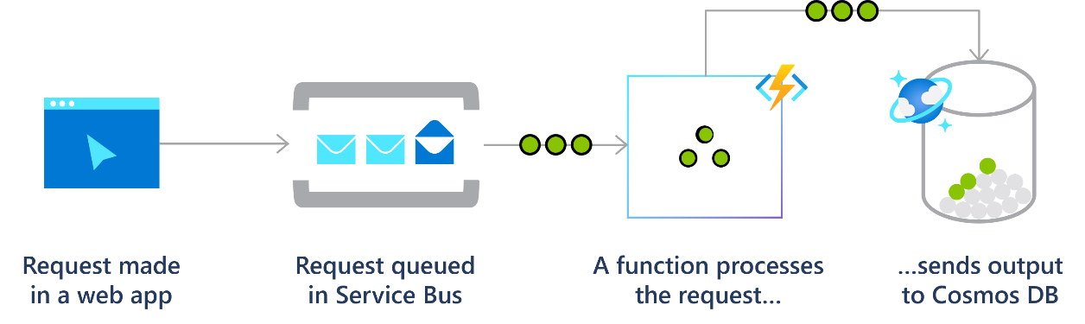
Sample scenarios for azure functıons
Real-time stream and event processing
Scheduled job: DB Clean Up
Processing file uploads
Reliable message system design

Slide 11
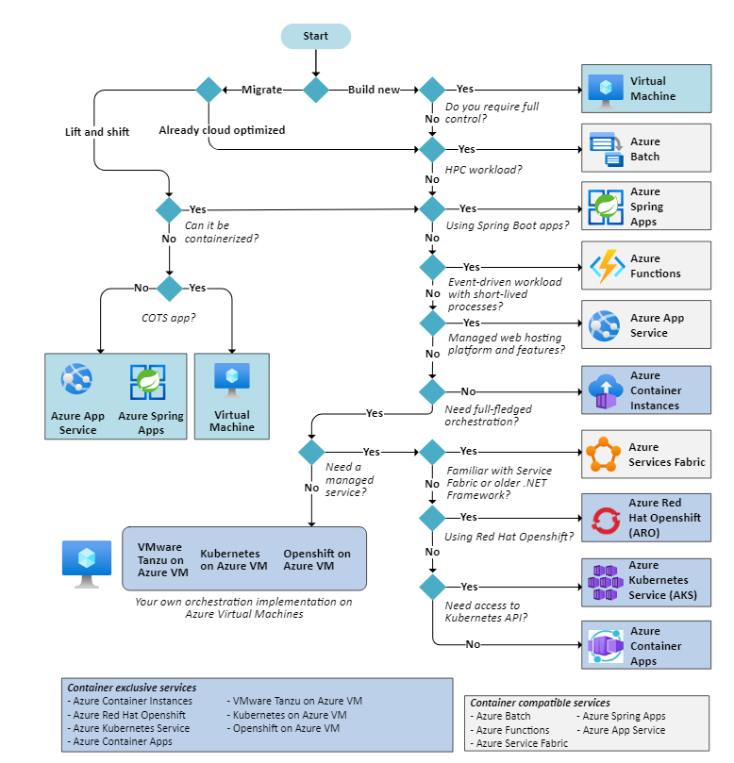
HOW TO CHOOSE A COMPUTE SERVICE

Slide 12
Lab Session

Slide 13
LAB#9: Testing COMPUTE INSTANCES ON CLOUD
Container App:
Follow the guideline:
https://learn.microsoft.com/en-us/azure/container-apps/quickstart-portal
https://learn.microsoft.com/en-us/azure/container-apps/get-started?tabs=bash

Slide 14
LAB#10: Testing COMPUTE INSTANCES ON CLOUD
AKS Setup & Test
Follow the instructions:
https://learn.microsoft.com/en-gb/training/modules/deploy-azure-kubernetes-service-cluster/9-create-azure-kubernetes-service

Slide 15
LAB#11: Testing COMPUTE INSTANCES ON CLOUD
Azure Functions setup and test.
Follow the instructions:
https://learn.microsoft.com/en-us/training/modules/develop-azure-functions/5-create-function-visual-studio-code

Slide 16
HOMEWORK
Compare AWS and Azure’s Container & Serverless compute services. Provide a short summary.
Research and provide a summary about the differences between the Cloud Network and Traditional Network.
Try to learn more about Network:
Subnetting #1: https://www.youtube.com/watch?v=bQ8sdpGQu8c (29 min. watch)
Subnetting #2: https://www.youtube.com/watch?v=IGhd-0di0Qo (25 min. watch)

Slide 17
Thank You

